Slide 1

Capstone Project Proposals: Lightning Talk #1
Fatema Alsabah
Data Science bootcamp – General Assembly

Slide 2

Goal: Evaluate 3 candidate datasets to select an impactful Capstone project.
Topic A
Topic B
Topic C
Factors Affecting Children Anemia Level (Classification / Public Health)
FoodMart Media Cost Prediction (Regression / Retail)
Stellar Classification SDSS DR17 (Classification / Astronomy)

Slide 3


Factors Affecting Children Anemia Level
Childhood anemia is a major public health challenge driven by a complex mix of factors. Identifying key risk drivers is essential for public health organizations to deploy targeted interventions effectively.
Problem Statement
Build a classification model to predict child anemia severity levels and help health organizations optimize resource allocation.
Goals and aims

Slide 4

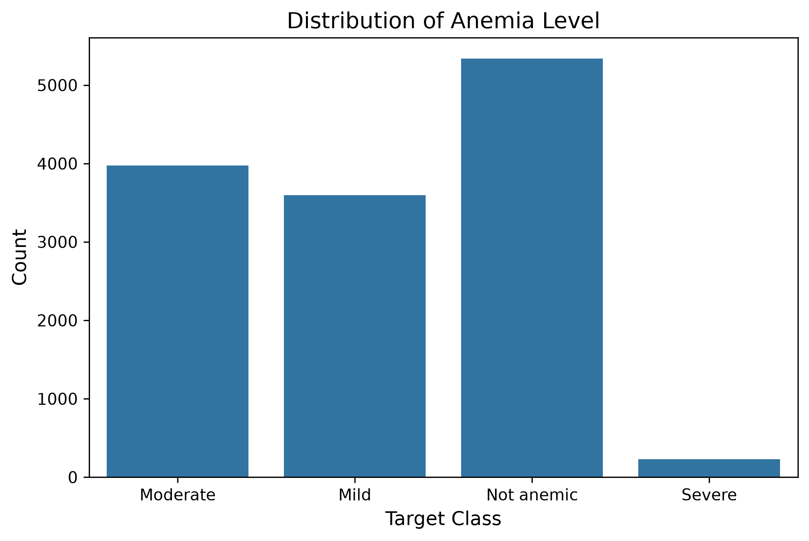
Insights about the data
1
There are missing values in 8 columns, the most notable are Anemia level, and Hemoglobin level adjusted for altitude. Both have many missing values.
40.63%
30.25%
2
27.36%
The number of numerical columns = 22
The number of categorical columns = 17
1.76%
3
Many columns have outliers such as: Age at 1st birth, Births in last five years, Hemoglobin level adjusted for altitude and smoking

Slide 5

FoodMart Media Cost Prediction
Retail chains lose substantial capital on inefficient promotional campaigns because marketing cost varies drastically across store layouts, media types, and customer demographics.
Problem Statement
Goals and aims
Build a regression model to accurately predict promotional media costs (Cost), allowing marketing managers to optimize advertising budget allocation.

Slide 6
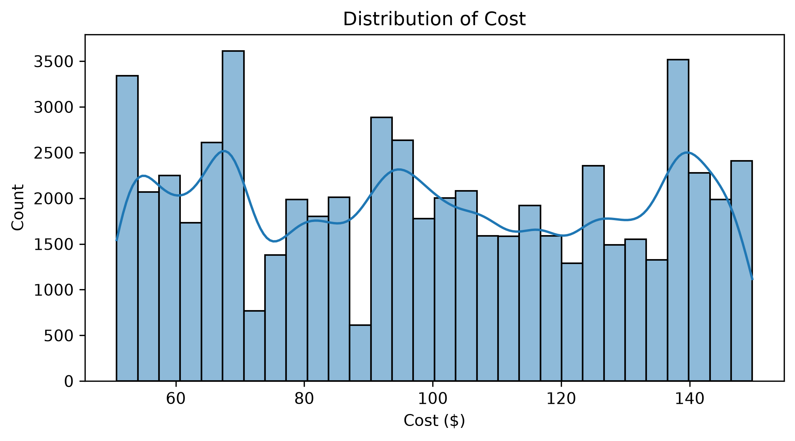
Insights about the data
1
There are no missing values in any of the columns of the dataset
2
The number of numerical columns = 22
The number of categorical columns = 17
3
6 columns have outliers: meat_sqft, frozen_sqft, num_children_at_home, store_cost(in millions), unit_sales(in millions), store_sales(in millions)

Slide 7
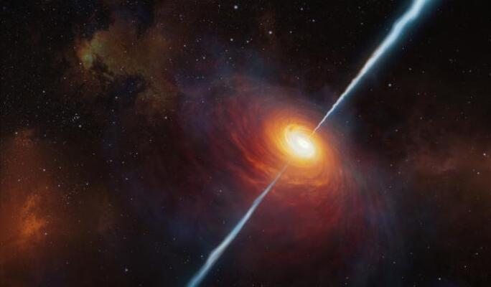
Stellar Classification Dataset - SDSS17
Modern automated space telescopes collect massive volumes of sky survey data, making manual optical inspection far too slow and labor intensive for astronomical research.
Problem Statement
Goals and aims
Build a classification model using photometric spectral filter data and redshift to classify space objects rapidly.

Slide 8
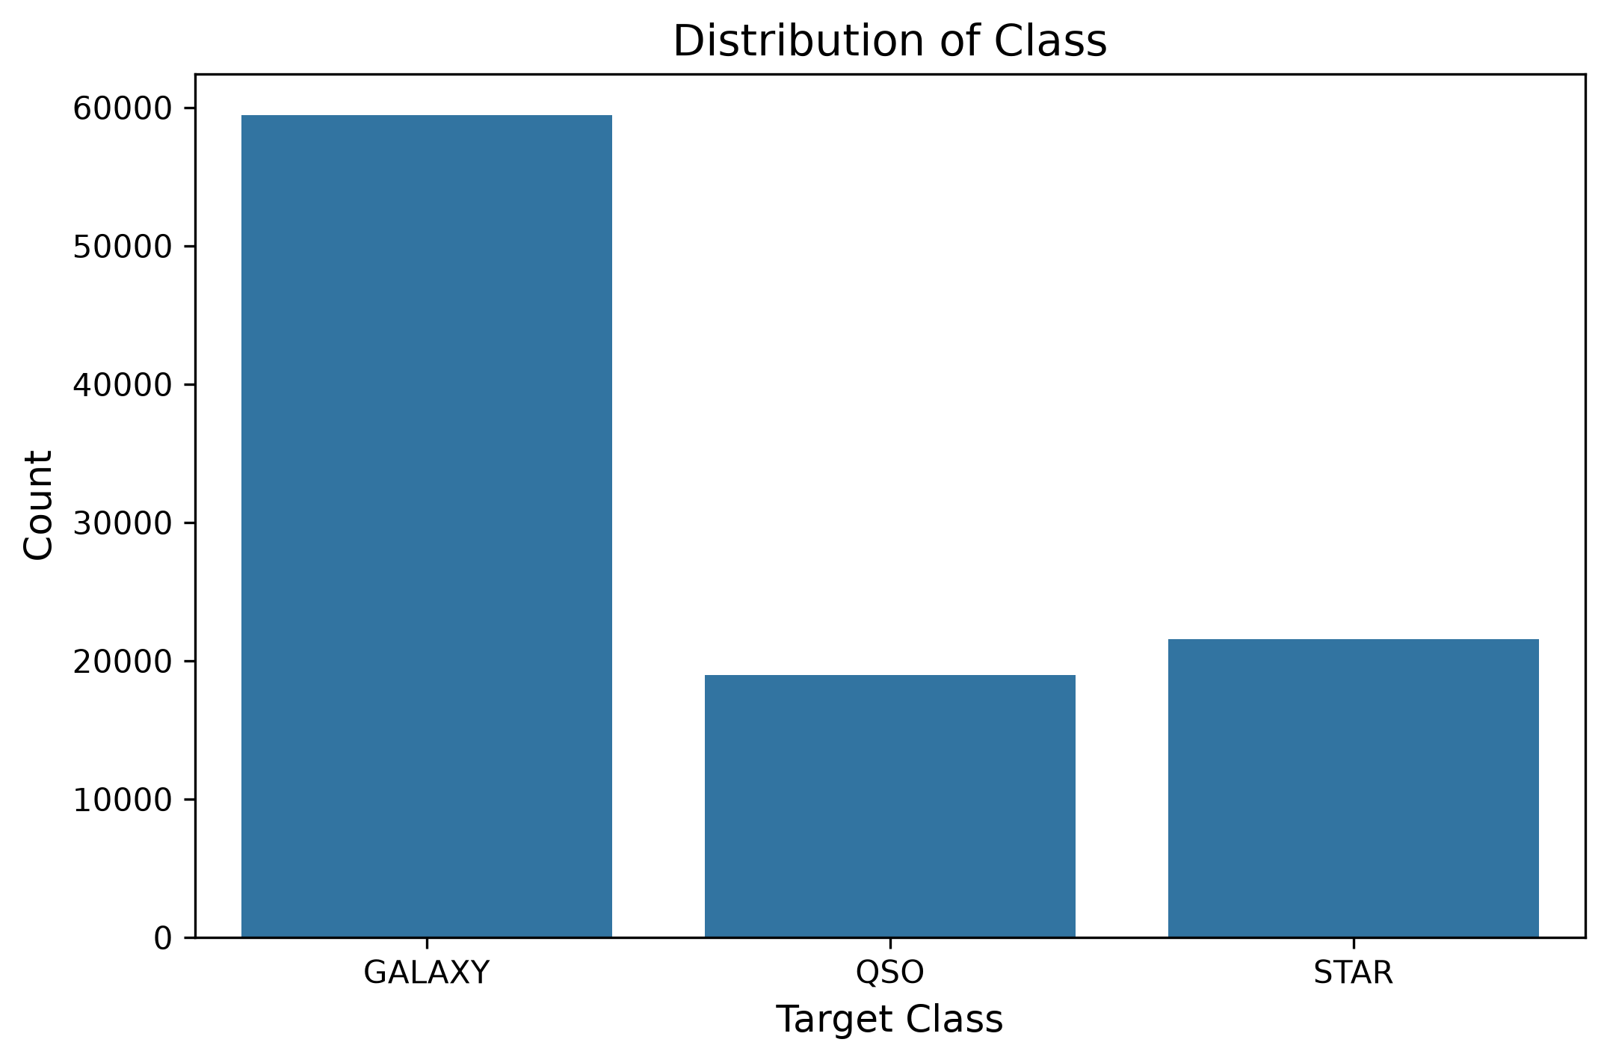
Insights about the data
1
There are no missing values in any of the columns of the dataset
59.44%
2
The number of numerical columns = 4
The number of categorical columns = 12
18.96%
21.59%
3
7 columns have outliers: redshift, field_ID, z (infrared), i (near-infrared), r (red), g (green), u (ultraviolet)

Slide 9

THANK YOU

